Slide 1
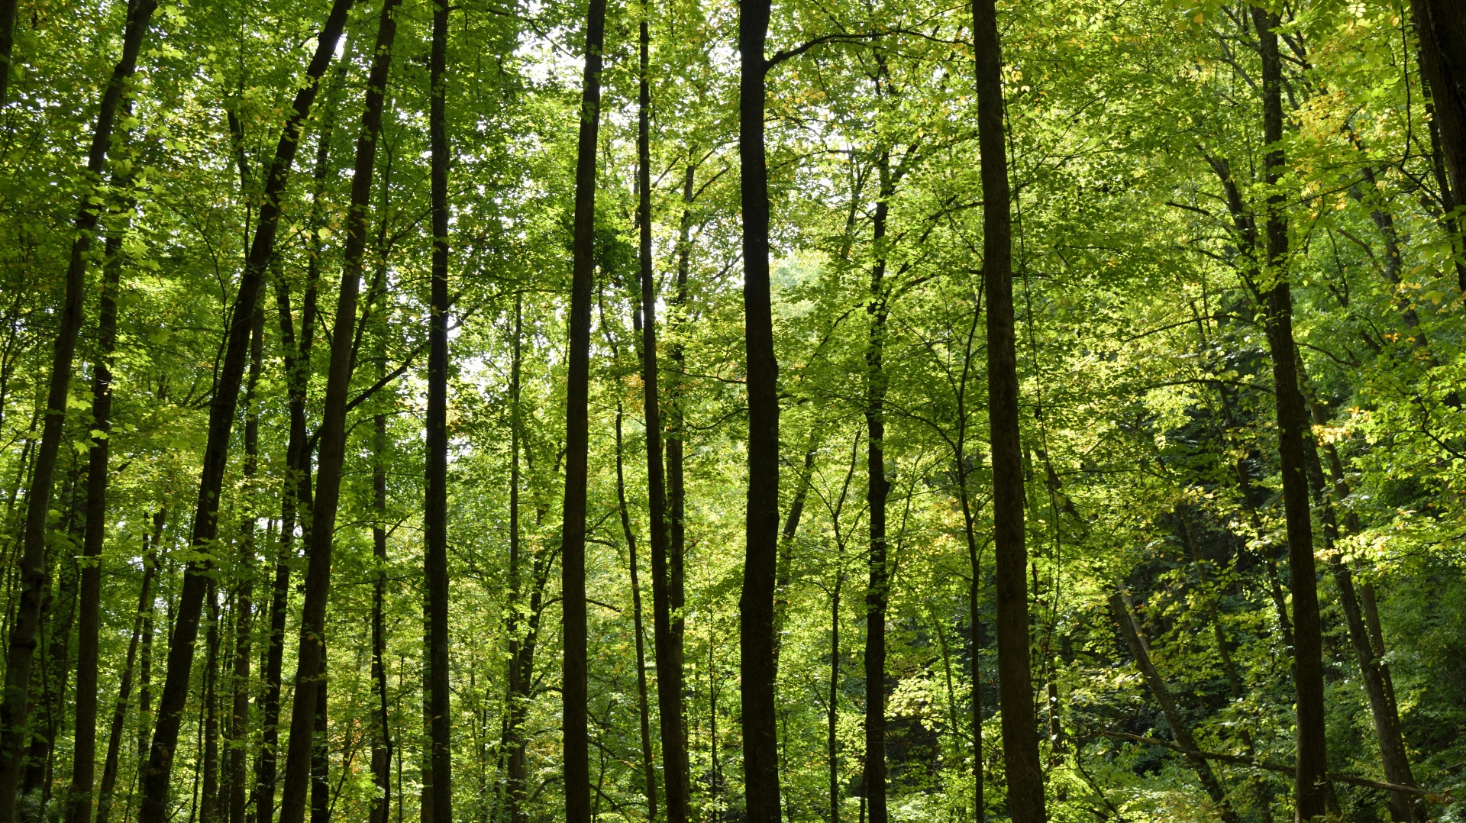
A Visual Analysis of World's Forest Cover
SRUTHI GATTA
015284165

Slide 2
Project Information
An attempt to analyze world's forest cover
Data is collected from Food and Agriculture Organization of the United Nations
Analysis covers the Reforestation, Deforestation, land use rates of World countries over the Years
Factors contributing to degrading Forest Cover

Slide 3
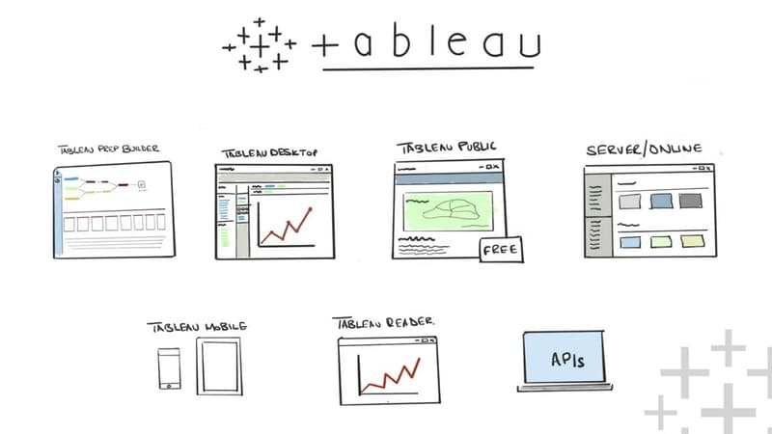
Tools
Tableau Prep Builder
Tableau Online
Tableau Desktop
This Photo by Unknown author is licensed under CC BY-NC-ND.

Slide 4
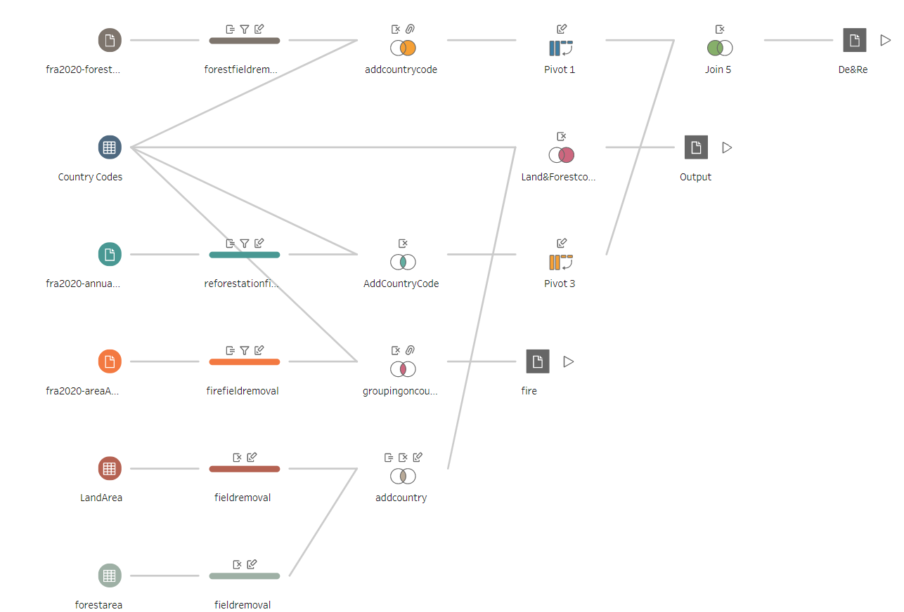
Preprocess – Tableau Prep

Slide 5
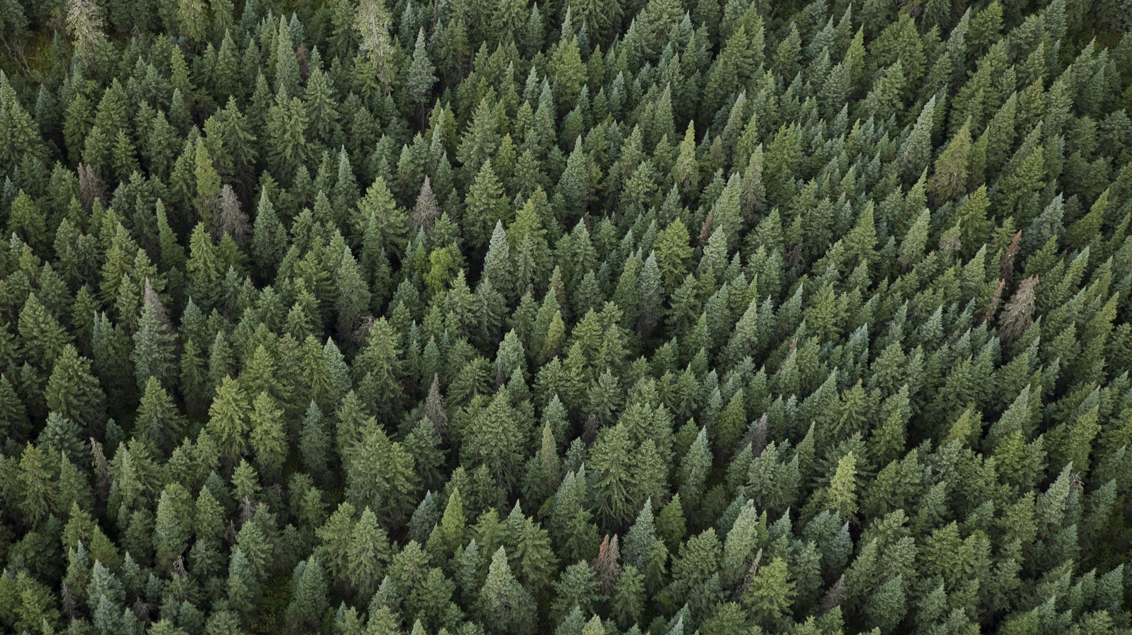
Forest Cover Distribution

Slide 6
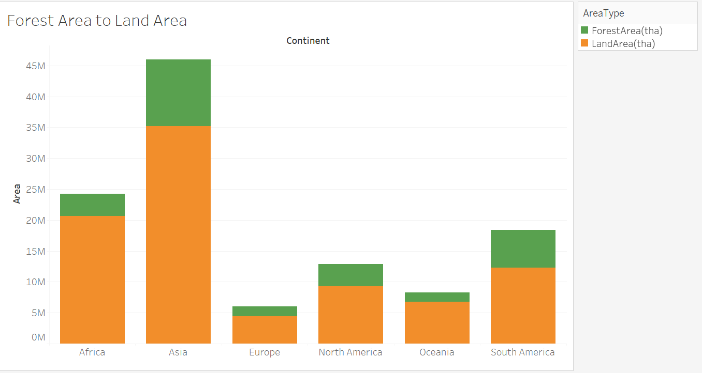
Forest to Land Area proportion in HA per Continent

Slide 7
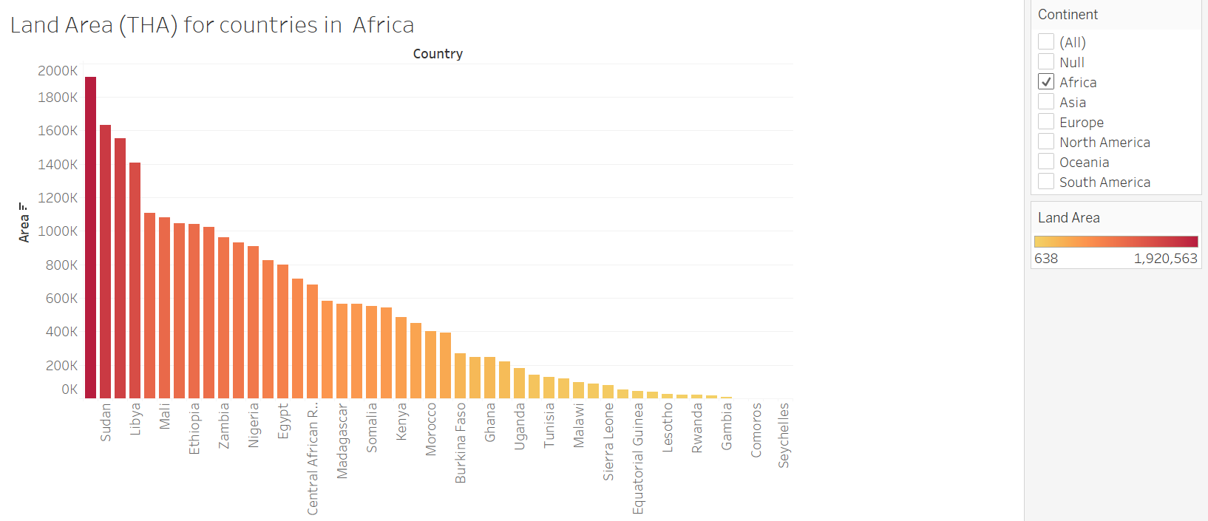
Land Area (THA) Analysis

Slide 8
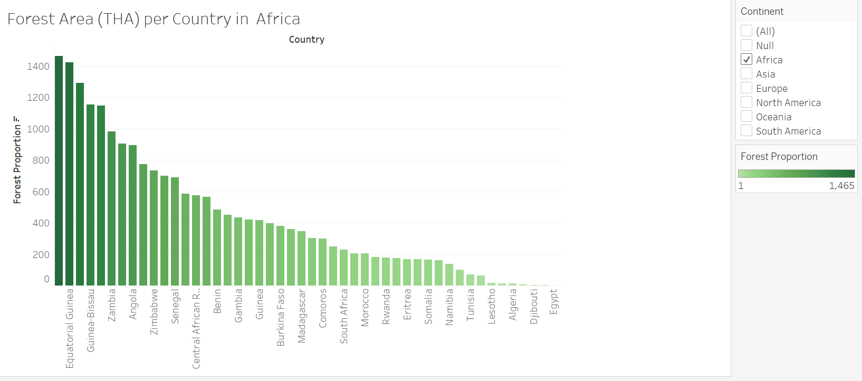
Forest Area (THA) Analysis

Slide 9
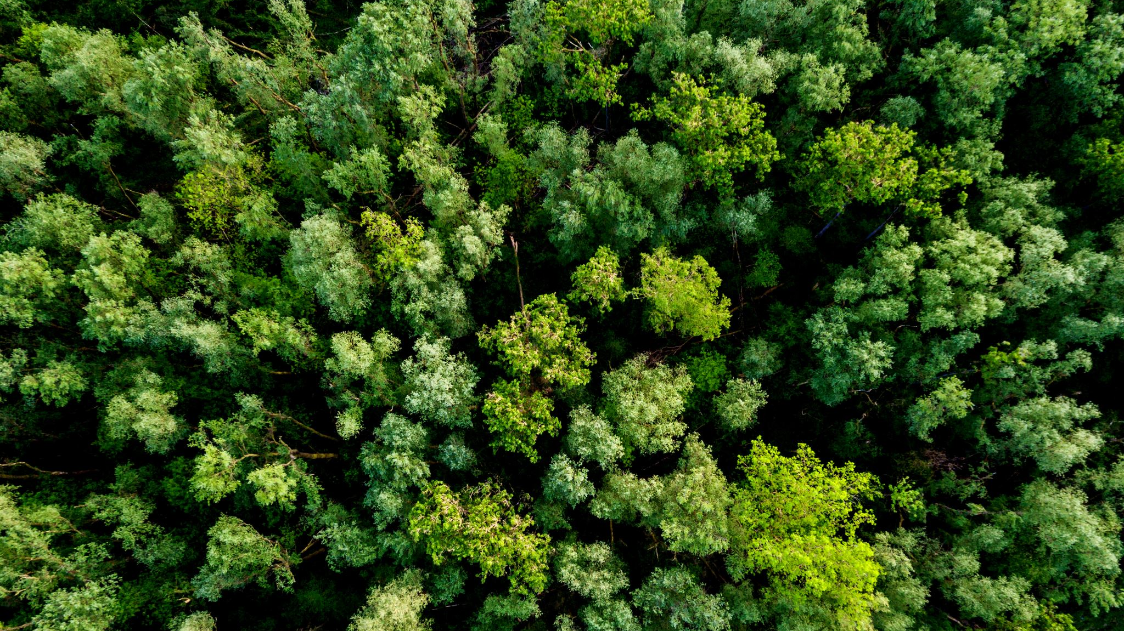
Forest Cover Loss Indicators

Slide 10
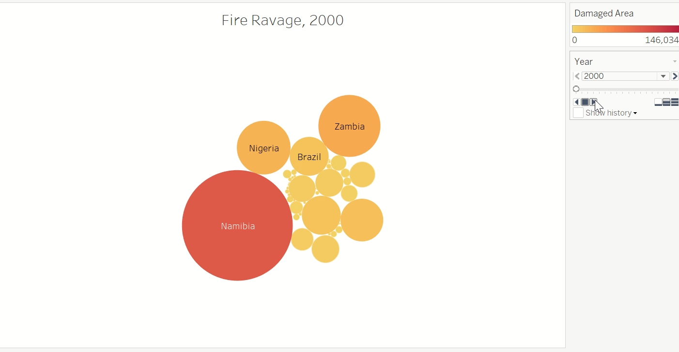

Slide 11
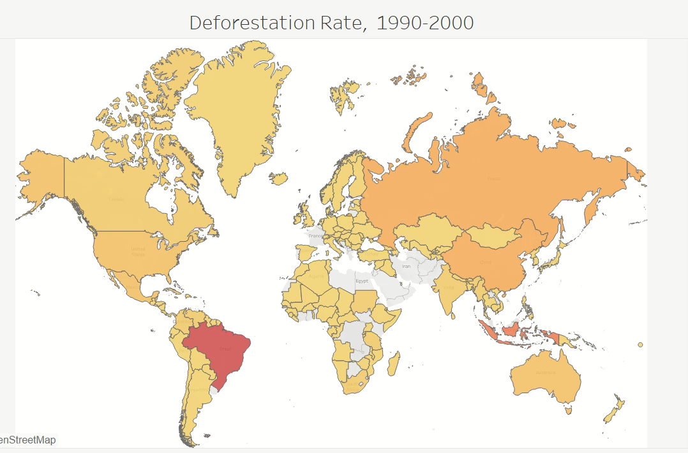

Slide 12

Sustainability Efforts

Slide 13
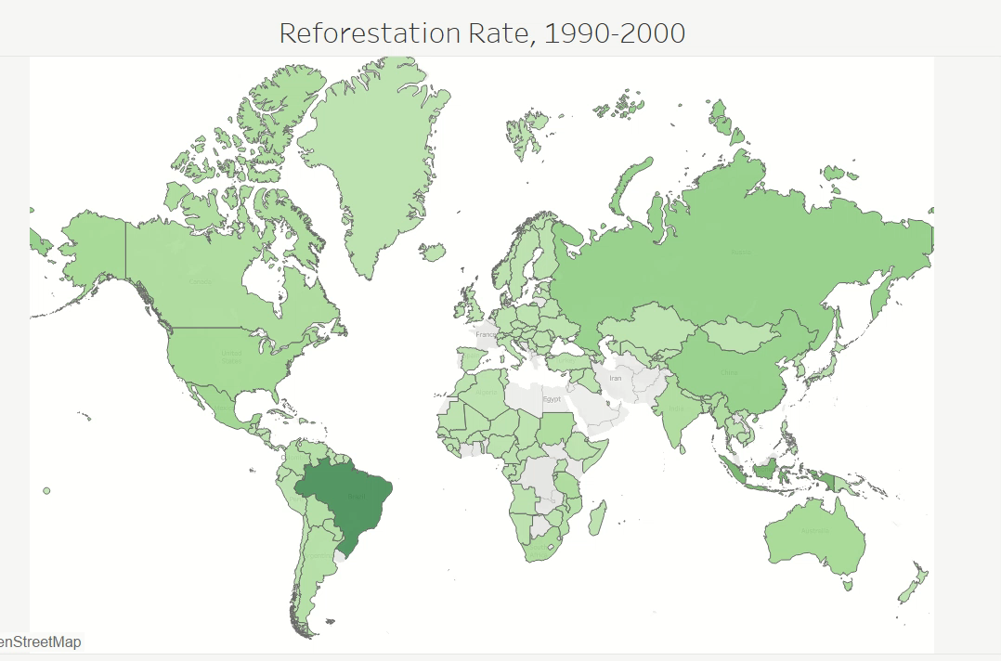

Slide 14
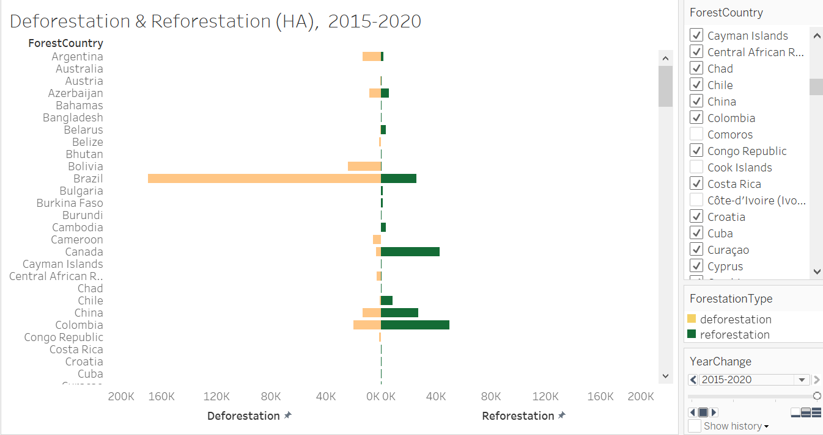

Slide 15
Findings
African Continent is being ravaged by forest fires with rise in forest cover loss every year.
Brazil has emerged in forest fire statistics from 2010, and the country is being ravaged by the fires ever since.
Man made deforestation is on rise in Brazil from 2000
According to the FAO, the global rate of deforestation in 2010 was 5.69Mha per year.
According to the FAO, the global rate of reforestation in 2010 was 27.3Mha per year.
While Brazil has lost 81% of its forest cover until 2010
The visuals shows, an equal rise in reforestation efforts in Brazil from 2010.

Slide 16
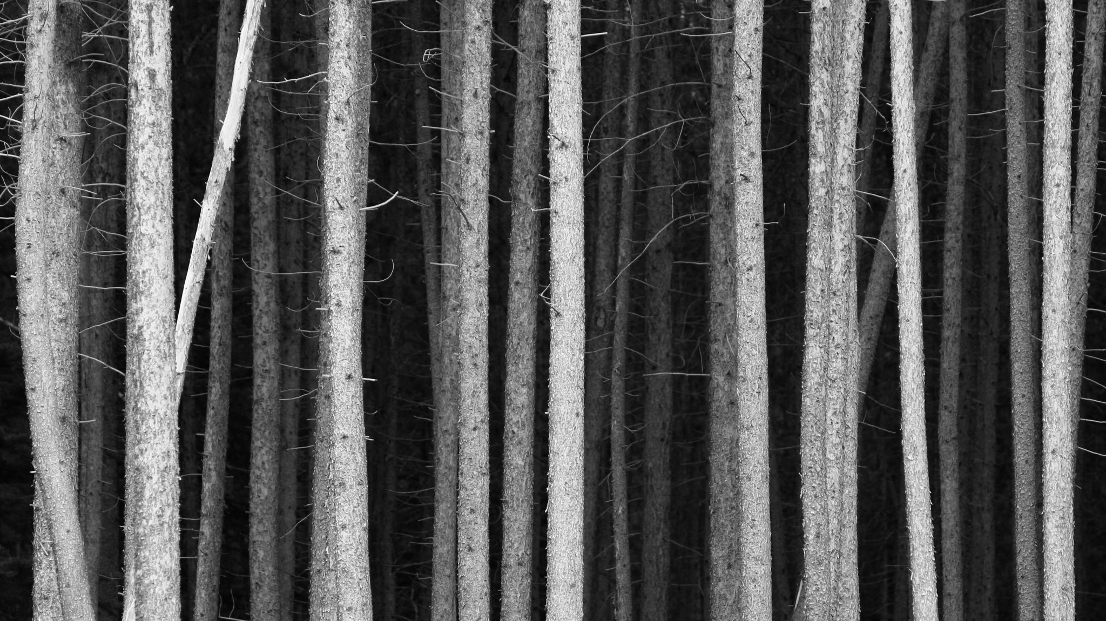
Conclusion
Let’s do our part in encouraging and creating awareness about the importance of forests and growing trees for better, cleaner, healthier future of the Earth.

